Slide 1
CSE350 Network Security
Assignment 2: (Project 0) RSA-based Public-key Certification Authority (CA)
Mohammed Kaif – 2020084
Arya Sinha - 2020498

Slide 2
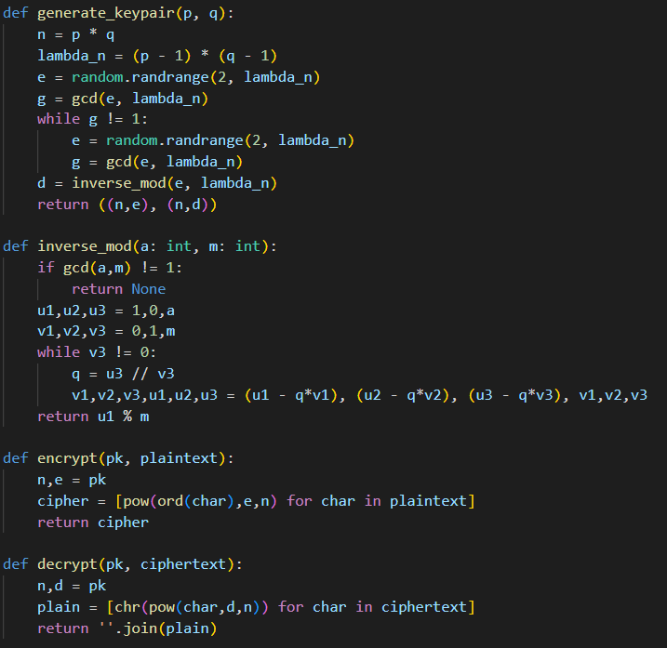
RSA Implementation
RSA has been implemented from scratch in the helper my_rsa.py file.
Functions
generate_keypair(p, q) - This function takes two prime numbers p and q as inputs and returns the public key as (n, e) and the private key as (n, d).
inverse_mod(a, m) - This function takes two integers a and m as inputs and returns the modular multiplicative inverse of a modulo m, for co-prime numbers a and m.
encrypt(pk, plaintext) - This function takes a public key pk and a plaintext string as inputs and returns the corresponding ciphertext as a list of integers.
decrypt(pk, ciphertext) - This function takes a private key pk and a ciphertext as a list of integers as inputs and returns the corresponding plaintext string.

Slide 3
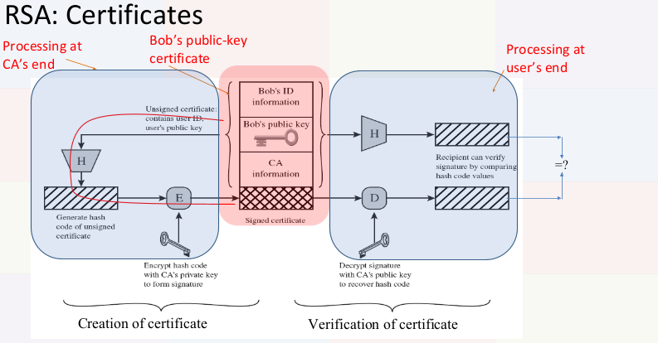

Slide 4
Certificate structure
CERT_{A} == [ID_{A}, PU_{A}, T_{A}, DUR_{A}, INFO_{CA}, ENC_{PR_CA}(Hash(ID_{A}, PU_{A}, T_{A}, DUR_{A}, INFO_{CA}))]
where
ID_{A} is user ID
PU_{A} is public key of A
T_{A} is time of issuance of certificate
DUR_{A} is the duration for which the certificate is valid
INFO_{CA} is information about certification authority
ENC is the encryption algorithm used by CA
PR_{CA} is public key of certification authority
Hash: Hashing function used is SHA-256

Slide 5
Any registered user can perform the following actions:
1. Request CA for certificate
2. Check available certificates
3. Make/Update my certificate
4. Check my certificate validity
5. Send message
6. Check messages
7. Logout
Pre registered clients and CA have the following credentials:
C = CA(ID: 2106, p: 67, q: 79)
clients[1] = client(ID: 1, p: 61, q: 53, C.public_key)
clients[2] = client(ID: 2, p: 83, q: 97, C.public_key)
Q. Who generates the pair of keys, viz. [private-key, public-key] for the clients?
This is done by the clients at the time of registration. They input their chosen values of p and q and a subsequent pair of [private-key, public-key] is generated based on that.
Q. How does the CA and/or client get to know it?
Each time a new client is registered, the CA is notified of its public key. The client selects the option ‘Make/Update my certificate’ to issue a certificate for themself. This certificate is stored with the CA and can be requested by any client using the option ‘Request CA for certificate’.

